Slide 1
Gesture Remote Control
ECE 4180 - Final Project

Slide 2
Team members
Tue Tran
Carden Bagwell
Sam Jackson

Slide 3
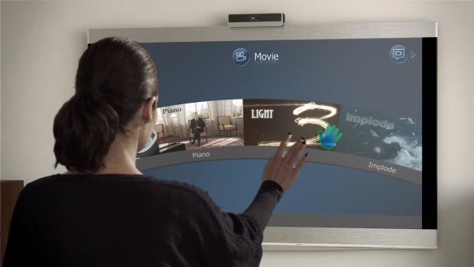
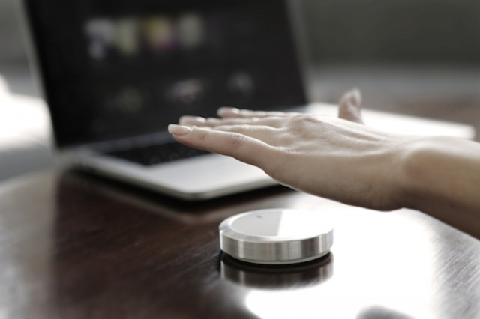
Ideas
Channel control
Up/Down based on swiping at different depth
Volume control
Up/Down based on holding at different depth
Power (on/off)
Input selection
Directional navigation
Settings menu
Channel guide
Add a numpad
Fully 2 dimensional control for Apple TV

Slide 4
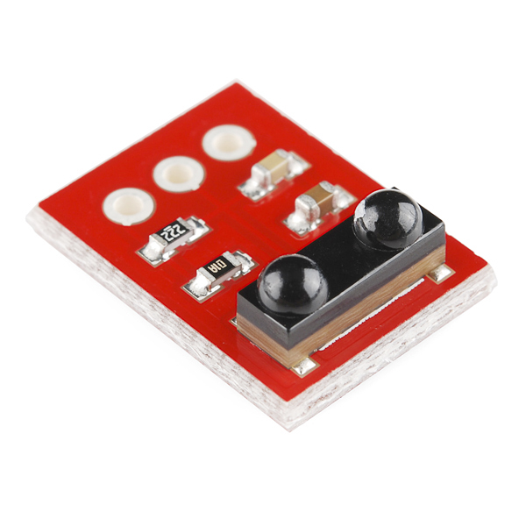
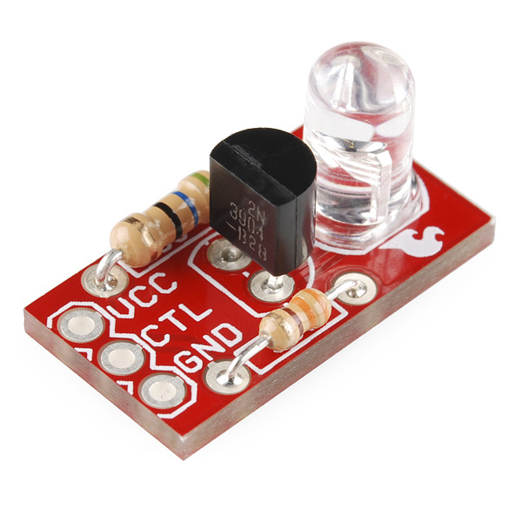
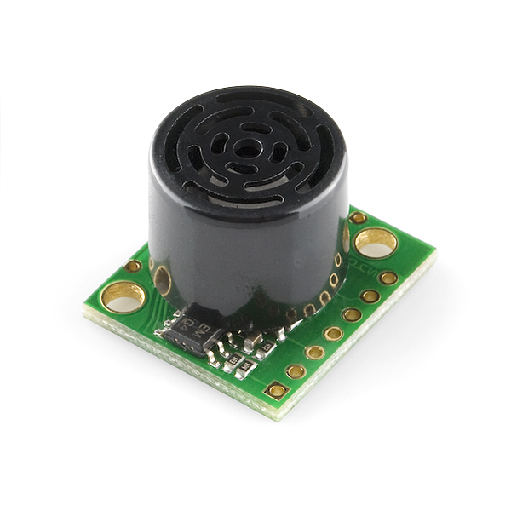
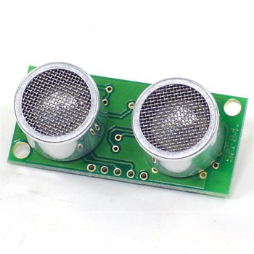
Parts
mbed NXP LPC1768
SparkFun IR receiver TSOP85
https://www.sparkfun.com/products/8554
SparkFun Power IR LED
https://www.sparkfun.com/products/retired/10732
SparkFun Ultrasonic Range Finder EZ1
https://www.sparkfun.com/products/639
And/Or Polaroid Ultrasonic Ranger SRF04
http://www.robot-electronics.co.uk/htm/srf04tech.htm

Slide 5
Schedule
1st week - 11/20/2015
Capture TV IR signals
Send IR signals to TV without gesture control
2nd week - 11/24/2015
Develop gesture controls
Channel, volume, & power
3rd week - 12/04/2015
Deal with unexpected issues
Experiment with additional sensors:
more than one IR sensor
gesture sensor
4th week - 12/08/2015: Final Presentation

